Slide 1


Department of CSE( Artificial Intelligence and Machine Learning)
KIT’s COLLEGE OF ENGINEERING, KOLHAPUR
Project title
VIRTUAL MOUSE

Slide 2
TEAM MEMBERS
Roll.No.
First Name
Middle Name
Surname
PRN.
78
Vishal
Bhimgonda
Desai
2425010086
75
Virendra
Balasaheb
Desai
2425010010
80
Aftabalam
Iqbal
Makandar
2425010026
81
Prathamesh
Suresh
Mane
2425010119

Slide 3
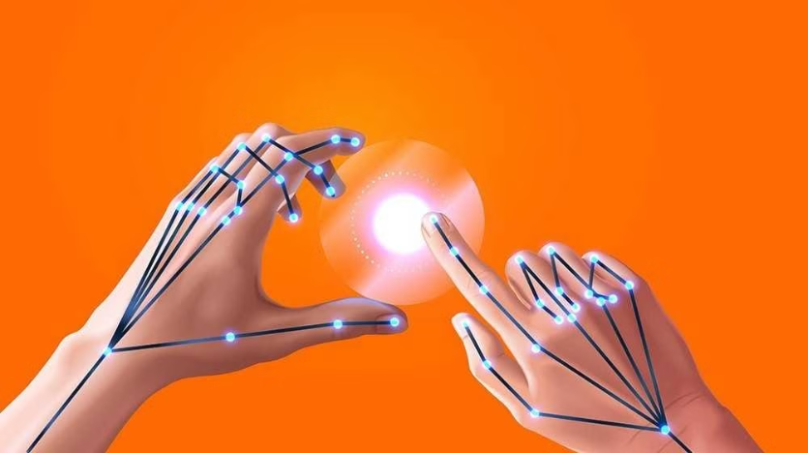
Virtual Mouse
A virtual mouse is a software-based input device that allows users to control their computer or mobile device without a physical mouse.

Slide 4

How it Works
Hand Gesture Control
Virtual mouse often use hand or finger movements to control the cursor, enabling users to point, click, scroll, and navigate through various applications.

Slide 5
Key Features
Precision Control
Customization
Accessibility
Virtual mouse often offer advanced cursor control, enabling users to make precise movements and selections with ease.
Many virtual mouse solutions allow users to customize the interface, gestures, and settings to suit their personal preferences.
Virtual mice provide an alternative input method for individuals with physical disabilities or limitations, improving accessibility and inclusivity.

Slide 6
Benefits of Using a Virtual Mouse
Comfort
Increased Mobility
Virtual mice reduce the risk of repetitive strain injuries associated with prolonged use of a traditional mouse.
Without the need for a physical mouse, users can navigate their devices from a distance or in confined spaces.
Improved Efficiency
Hygienic Solution
Virtual mice often enable faster and more intuitive cursor control, boosting productivity and workflow.
Virtual mice eliminate the need to touch a shared physical device, promoting a more hygienic work environment.

Slide 7
Comparison to Traditional Mouse
Ergonomics
Mobility
Precision
Virtual mice offer a more ergonomic and comfortable user experience, reducing strain on the hand and wrist.
Virtual mice allow for hands-free control and navigation, enabling users to move around freely without being tethered to a desk.
While traditional mice excel at precise cursor control, some virtual mouse solutions can match or even surpass their accuracy.

Slide 8


Compatibility and Devices
Desktops
Laptops
Virtual mice are compatible with a wide range of desktop computers, including Windows, macOS, and Linux systems.
Many virtual mouse solutions are designed to integrate seamlessly with laptops, providing a convenient hands-free input option.

Slide 9




Applications and Use Cases
Accessibility
Remote Work
Gaming
Healthcare
Providing an alternative input method for individuals with physical disabilities or limitations.
Enabling hands-free control and navigation during video conferences or presentations.
Enhancing gameplay experience by offering precise cursor control and hands-free navigation.
Improving hygiene and reducing cross-contamination in medical settings.

Slide 10
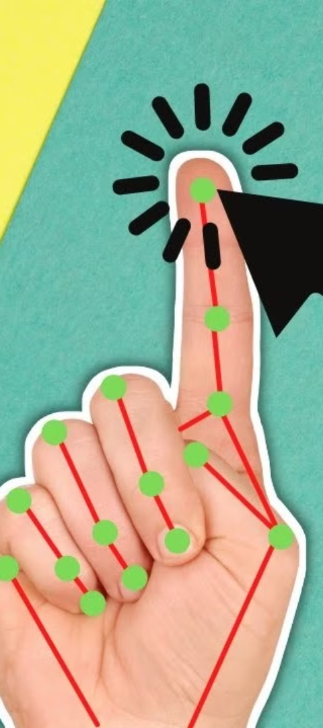
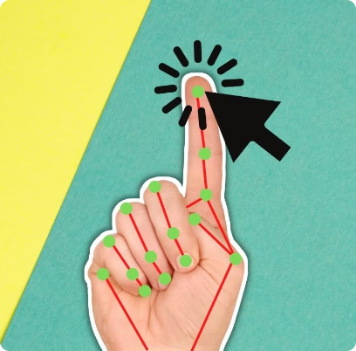
Getting Started with a Virtual Mouse
1
Research
Explore the different virtual mouse solutions available and compare their features to find the one that best suits your needs.
2
Set up
Follow the manufacturer's instructions to properly install and configure the virtual mouse software or hardware on your device.
3
Practice
Take some time to get familiar with the controls and gestures, ensuring a smooth transition from a traditional mouse.

Slide 11
Software Requirements:
VSCODE EDITOR.
OPEN-CV LIBRARY.
NUMPY LIBRARY.
MEDIAPIPE LIBRARY
AUTOPY LIBRARY

Slide 12
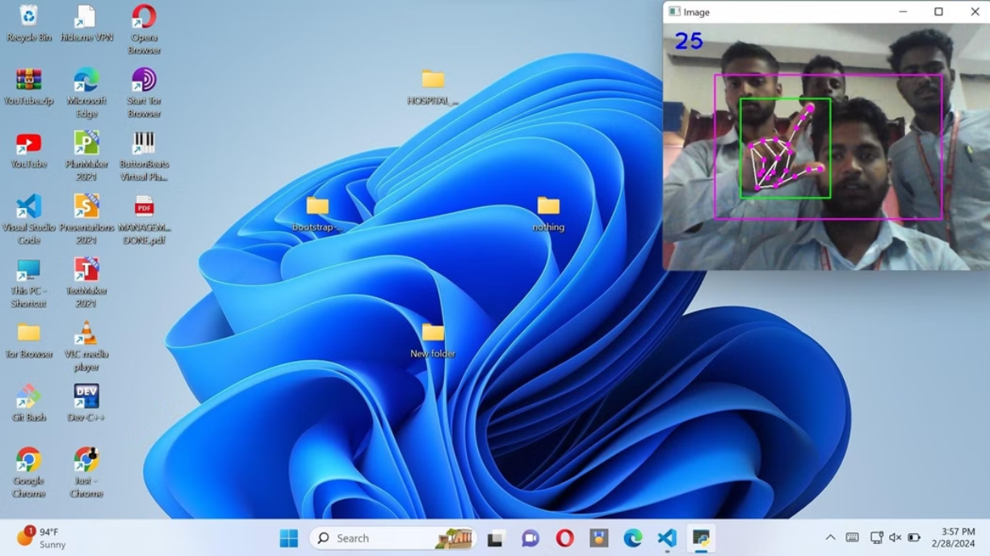
Single Click

Slide 13

Double Click

Slide 14
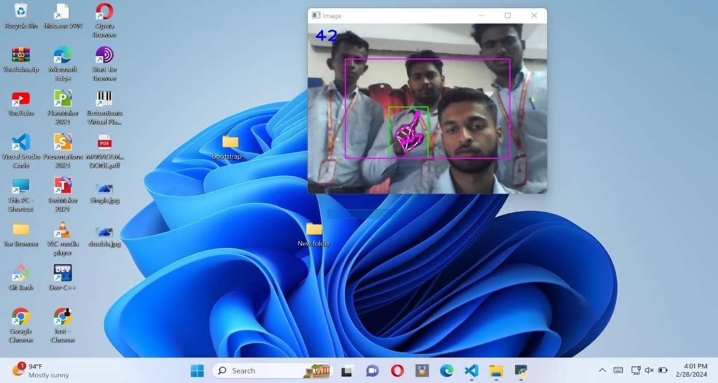
Drag and Drop

Slide 15
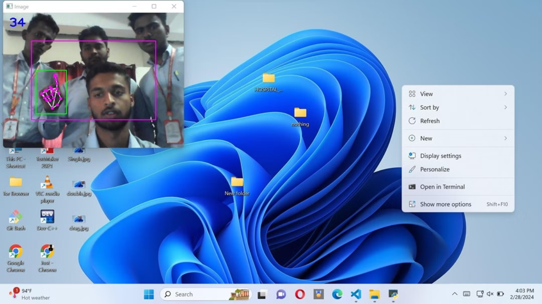
Right Click

Slide 16
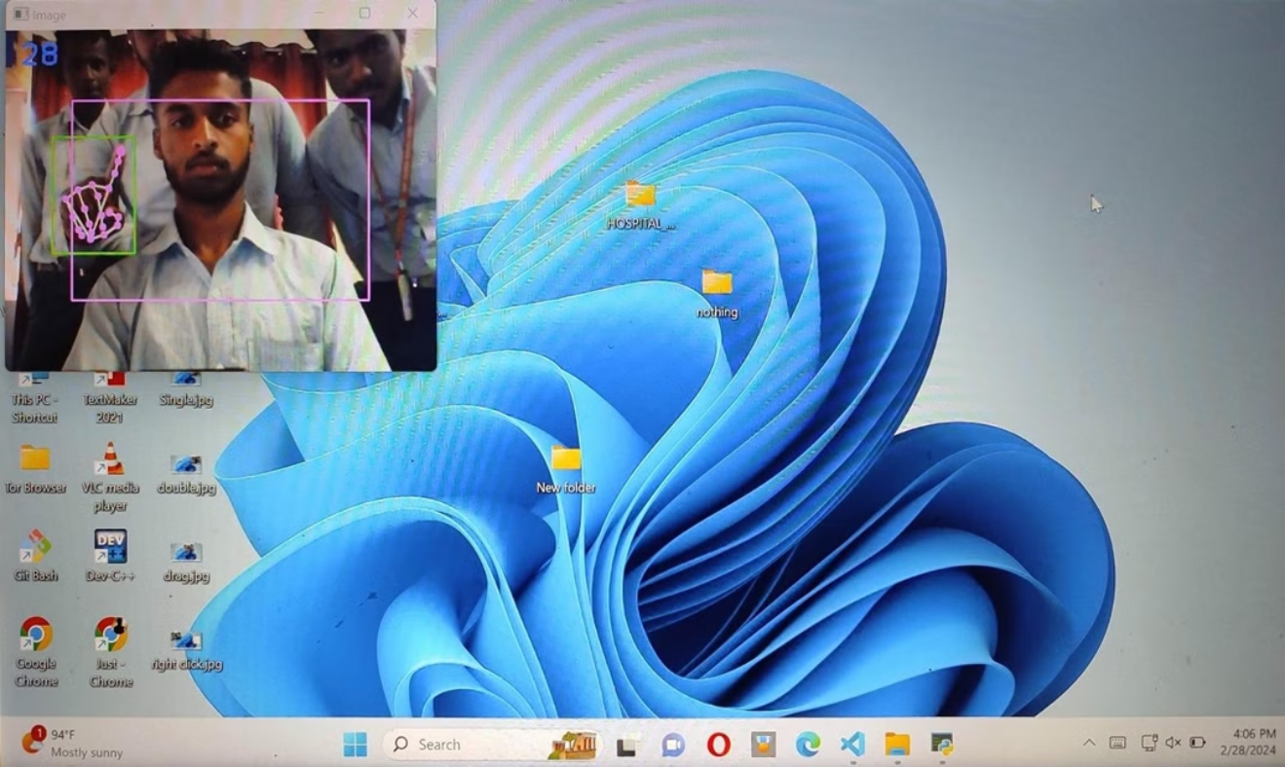
Movement

Slide 17
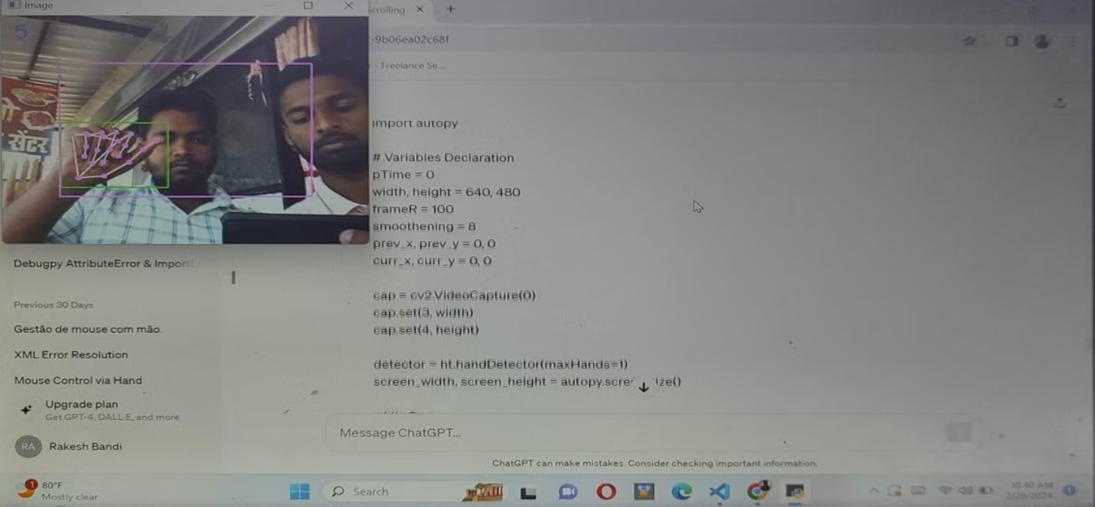
Scrolling

Slide 18
THANK YOU

